Slide 1
Five-a-Day Year 7
HIAS D&T Team Home Learning Resource
Food and Nutrition

Slide 2
Year 7 : Five a day NAME: DATE:
Look and learn: Almost all fruit and vegetables count towards your 5 A DAY, making it easier than you may think to get your recommended amount each day. Fruit and vegetables don’t have to be fresh to count as a portion. Nor do they have to be eaten on their own: they also count if they're part of a meal or dish.
Practise: Can you find ten different fruit and vegetables that count towards your five a day?
Challenge: Produce a day's menu to include 5 portions of fruit and vegetables.

Slide 3
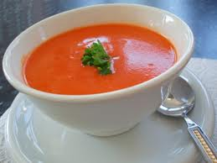
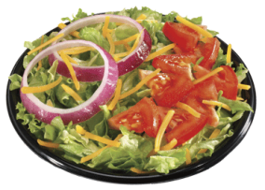
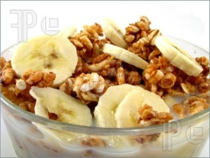
My 5 a day menu
Breakfast
Lunch
Evening Meal
Snacks and drinks
I have chosen the above dishes because ……………………………………………………………………………………………………………………………………………………………………………………………………………………..................................................................................
…………………………………………………………………………………………
………………………………………………………………………………………
..........................................................................………………

