Slide 1
Using a Knife Year 7
HIAS D&T Team Home Learning Resource
Food and Nutrition

Slide 2
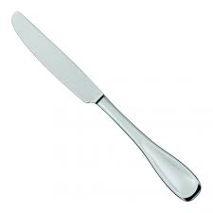
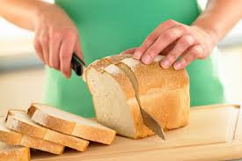
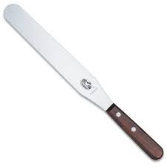
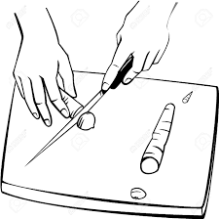
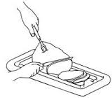
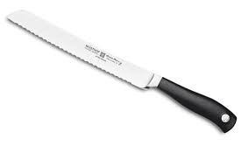
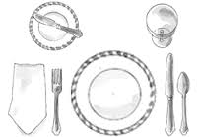
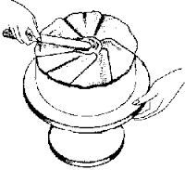
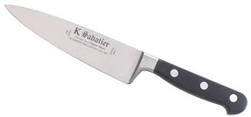
Year 7 Using a knife. Name: Date:
Look and learn: Knives can be very dangerous. Always carry sharp knives carefully by the handle with the base pointing to the floor. Knives should be used with a chopping board. There are a wide variety of knives available to a cater and each knife has a special job.
Practise: Look at the different types of knives shown below. The pictures showing their uses have been mixed up. Draw a line to match each knife to its correct use. The first one has been done for you.
Type of knife
Table knife
Palette knife
Bread knife
Vegetable knife
Large cook’s knife
Use
For slicing bread
Slicing vegetables
Carving meat
For eating meals with
For spreading Icing on top Of cakes

Slide 3
Challenge: Can you tell me ways in which a knife can be used safely? There are at least 5 rules.
………………………………………………………………………………………………………………………………………………………………………………………………………………………………………………………………………………………………………………………………………………………………………………………………………………………………………………………………………………………………………………………………………………………………………………………………………………………………………………………………………………………………………………………………………………………………………………………………………………………………………………………………………………………………………………………………………………………………………………………………………………………………………………………………………………………………………………………………………………………………………………………………………………………………………………
falling sink grease-free handle correct count store

