Slide 1
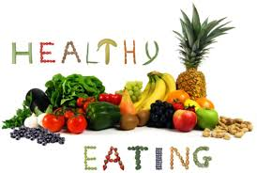
HIAS D&T Team Home Learning Resource
Year 7 and Year 8
Food and Nutrition
Name:
Teacher:
Group: | Target Grade:
Instructions:
This remote learning booklet has a range of activities in it that should last for approximately 7 hours

Slide 2
Health and Safety – Quick Revision
Match up the health and safety rule with the correct reason in the list below. The first one has been done for you.
1. Mop up spills immediately |  | to reduce the risk of food poisoning
2. Wash your hands |  | so you can’t electrocute yourself
3. Tie back long hair |  | to prevent cross contamination
4. Always tuck bags and stools under the desk |  | to prevent hairs falling into food
5. Turn pan handles to the side on the hob |  | so they are safely out of the way and to prevent any trips / falls
6. Store foods at the correct temperature |  | to prevent any cuts or injuries
7. Carry sharp knives pointing downwards |  | to prevent slips and falls
8. Never handle electrical equipment with wet hands |  | so that no one can knock into them and knock them off the hob
9. Always wash your knife and chopping board after cutting raw meat |  | to remove visible dirt and bacteria
10. Do not touch your hair or face nor lick your fingers when cooking |  | as this is not hygienic
What is ‘cross contamination’?
What is the correct temperature for a fridge? __________________________
List four foods that are high risk foods -
List four foods that are low risk foods:

Slide 3
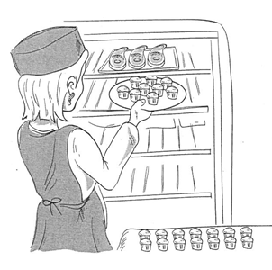
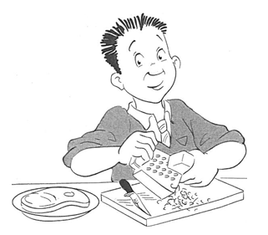
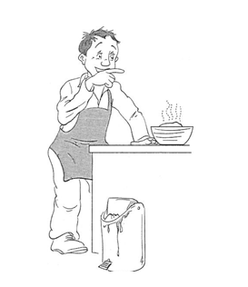
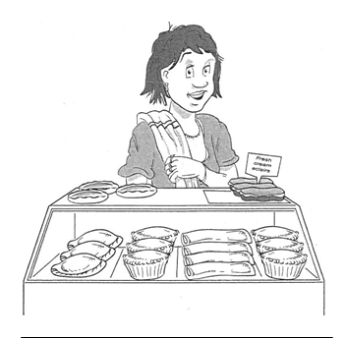
Health, hygiene and food safety revision
Look at the pictures below. List at least three possible hygiene or food safety issues that you can see in each picture.
1.
2.
3.
1.
2.
3.
1.
2.
3.
1.
2.
3.

Slide 4
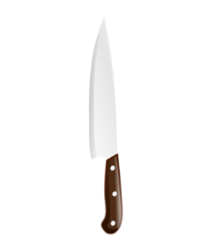
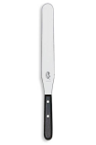
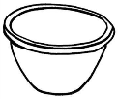
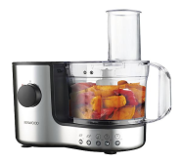
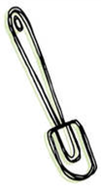
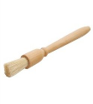
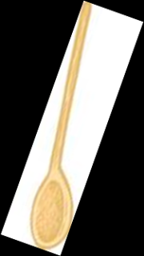
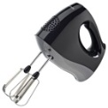
Kitchen Equipment Revision
Electric hand whisk, spatula, chopping board, food processor, measuring jug , rolling pin, mixing bowl , sieve, knife, grater , wooden spoon , palette knife, pastry brush , baking tray , digital weighing scales
Equipment | Name | Purpose
1. |  | Used for sifting flour
2. |  | A small knife for peeling or chopping
3. |  | Used to roll dough / pastries
4. |  | Used to remove products from baking trays
5. |  | A bowl used for mixing together ingredients
6. |  | Used for measuring out ingredients
7. |  | Used to make strips from cheese or vegetables
8. |  | A board used when chopping vegetables
9. |  | A electric kitchen appliance used for chopping, mixing, or pureeing foods
10. |  | Used to measure out liquids
11. |  | Used for getting mixture out of corner of bowls
12. |  | Used for brushing milk or egg onto pastry
13. |  | Used when baking food products in the oven
14. |  | Used for mixing either hot or cold mixtures
15. |  | Used for mixing air into mixtures

Slide 5
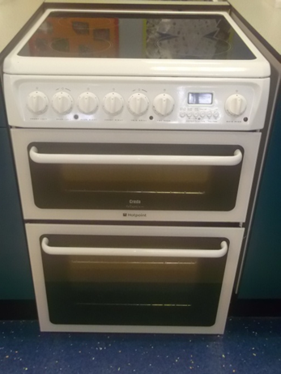
1. The Cooker Label the following parts of the cooker: hob, grill, oven, control panel, timer, main oven dial 2. Grill / Small Oven The grill is located below the control panel and can also double as a small oven. List three things which can be cooked under the grill? 1. 2. 3. 3. Main Oven The main oven is the largest part of the cooker where most of the cooking takes place, such as baking cakes or roasting a joint of meat. What does the term “preheat” mean?

Slide 6
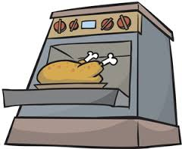
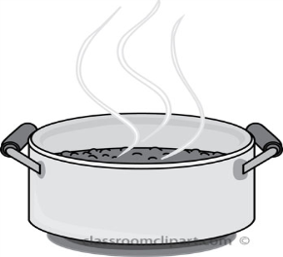
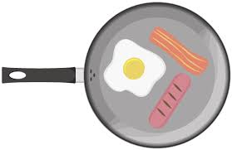
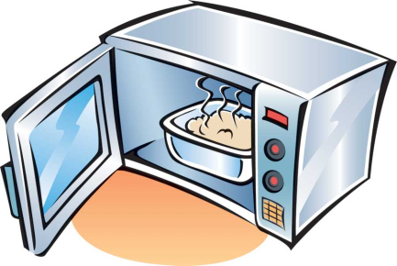
Cooking Methods
Match each cooking method to its description
Name a dish that uses each cooking method
Colour the words in RED that are dry methods and BLUE for moist
Cooking Method | Description
 | Food cooked over glowing coals or flame. Dish:_____________________________
 | Small pieces of food are fried lightly in a little hot oil . Dish: _____________________________
 | Cooking with electromagnetic waves. Good for reheating food. Dish:_______________________________
 | Food is cooked uncovered in a hot oven. Dish: _______________________________
 | Food is cooked very gently in liquid below simmering point. Dish:_______________________________
 | Gentle cooking in liquid just below boiling point. Dish:________________________________
 | Finely cut food rapidly stirred and tossed in a wok over a high heat. Dish:_________________________________
 | Quick cooking by direct heat from a gas flame or electric element. Dish:_________________________________
 | All ingredients added to one pot and cooked over a long time. Dish:_________________________________
 | Food cooked by being immersed in hot oil. Dish:_________________________________
 | Food cooked in liquid at boiling point, 100C Dish:_________________________________
Roast
Grill
Sauté
Barbeque
Stir Fry
Deep Fat Fry
Simmer
Poach
Microwave
Boiling
Stewing
Method:
Dish:
Method:
Dish:
Method:
Dish:
Method:
Dish:

Slide 7
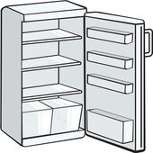
Storing Food Why is it important to store food in the correct place in the kitchen? Temperatures Fridge temperature should be Freezer temperature should be Where would you place the following foods in the fridge? a) Fresh pasta b) Eggs c) Carton of orange juice d) Cheese e) Cooked meats f) Opened tinned tomatoes g) Lettuce h) Pint milk i) Bacon k) Uncooked chicken l) Fresh cream cake
Write the letter in the correct place in the fridge
Temperature -What are the critical temperature zones ?

Slide 8
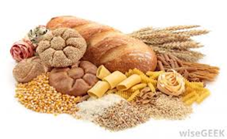
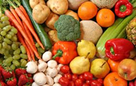
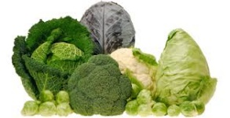
Nutrients – What a body needs
Nutrients
Nutrient | What do we need this for? | Sources (what foods it is found in)
Starch Sugar | Energy - Dietary fibre -
 | Growth Repair Maintenance
 | Energy Warmth Protection of organs Source of fat soluble vitamins
Fat soluble Water soluble | Helps with the reactions that take place in the body for energy release Helps by keeping the body healthy and preventing some diseases linked to a poor diet Helps to regulate the function and repair of cells
 | Turn the food we eat into energy Build strong bones and teeth helps formation of healthy red blood cells instead

Slide 9
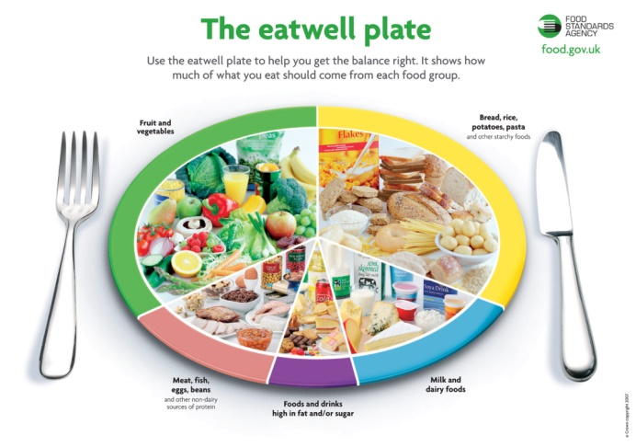
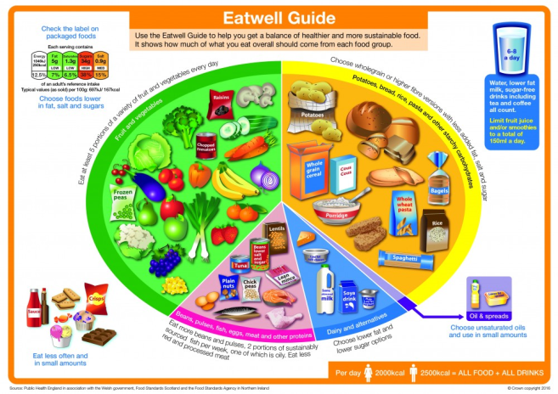
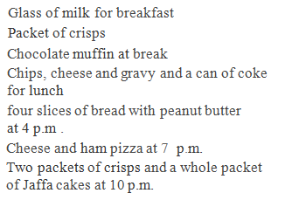
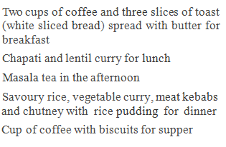
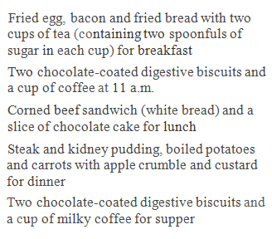
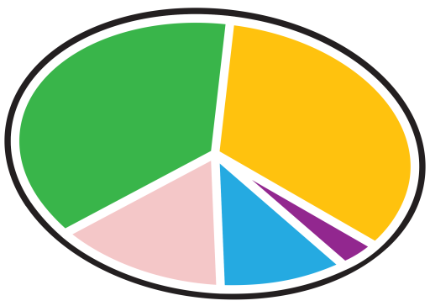
Eatwell Plate V Eatwell Guide
In 2015 the Government replaced their nutritional guide. The Eatwell Plate became the Eatwell Guide. Study the two images. What differences can you see? Are there any similarities between the two? Why do you think the Government has made these changes?
Is everyone getting the balance right?
Put the food for the different diets onto a balanced plate. How could they change what they are eating to make it healthier?
18-year-old boy
40-year-old office worker
Grandmother
Changes to diet:
Changes to diet:
Changes to diet:

Slide 10
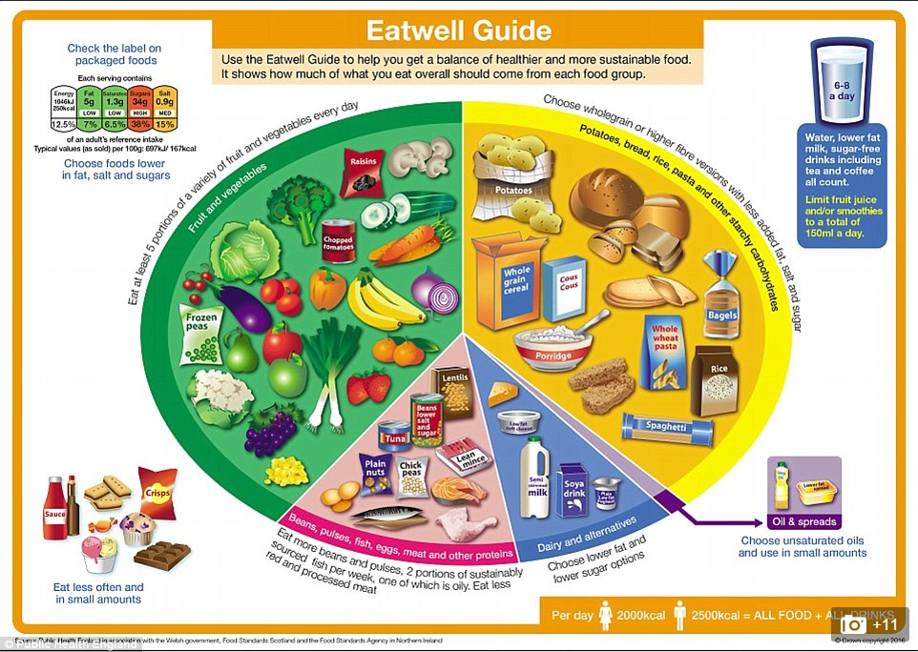
What are the 8 healthy eating guidelines?
Missing Words
Fats, breakfast, fruit, sugar, water, salt, healthy, fish, vegetables, fish , 6g
Healthy eating guidelines:
Base your meals on ______________foods
Eat lots of ______________ and ____________
Eat more _____________
Cut down on saturated ____________ and _____________
Eat less ____________. No more than ____ per day.
Get active and be a ____________________ weight
Rehydrate – drink more _______________
Don’t skip ________________

Slide 11
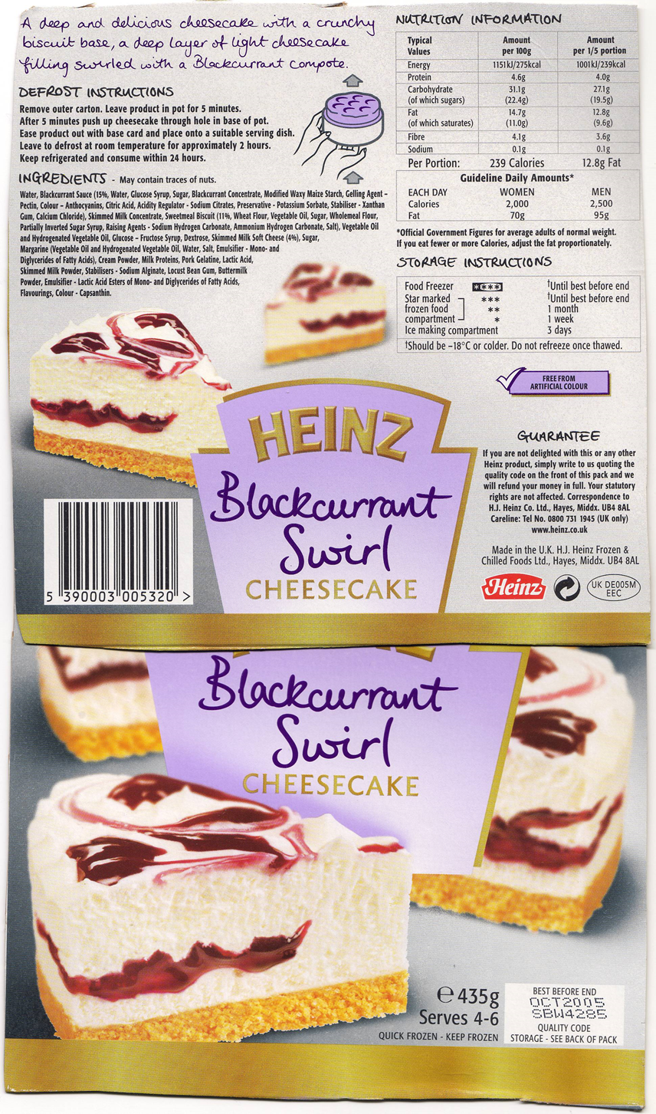
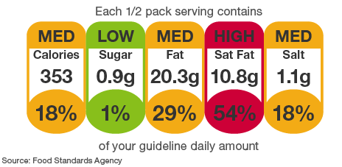
Food Labelling – Label all the compulsory and optional items that must be on a food label:
Product name
Key -
* These items have to be by law put onto all packaging
Nutritional Labelling
Nutrition labels can help you choose between products, and keep a check on the amount of foods high in fat, salt and added sugars that you're eating. All nutrition information is provided per 100 grams and sometimes per portion of the food.
What does the traffic light food colouring system mean?
What does this label mean?

Slide 12
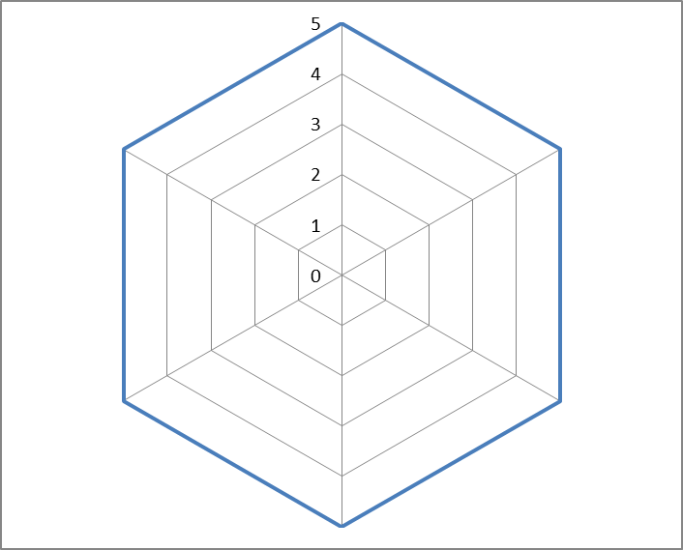
Product Analysis of a ready meal OR dessert that you have in your fridge OR select a product on www.tesco.com
General Information
Name of Product:
Main Ingredients: (look on the packaging sheet) | Nutrients Label: ( colour code ) What does this mean about this product?
Fats | Saturated fats | Sugars | salt
Draw the a cross section of the product below: (you need to label the different layers, colours, weight, size of each layer)
Star Profile
Dry
What does my star profile show?
Key:
1 = not at all
2 = slightly
3 = satisfactory
4 = quite
5 = very / excellent
Aroma
Appearance
Texture
Moist
Flavour

Slide 13
Strengths : Explain what you disliked about the product? Weaknesses :
Explain what you liked about the product?
How could you change a cheesecake?
 | Idea 1 | Idea 2 | Idea 3
Base:
Filling:
Decoration:
Base ingredients
Filling
Decoration

Slide 14
Obesity is becoming one of the most common childhood health problems in Europe and has the greatest impact for future negative health consequences (Chinn and Rona, 2001).
‘We are what we eat’.
An unbalanced diet will result in physical problems, such as weight gain or loss, decayed teeth or other illnesses. Choosing foods that provide the nutrients we need in the amounts our bodies require is an important part of being healthy and staying healthy.
Task:
Use your knowledge and the internet to research the questions below.
What are the healthy eating guidelines?
What is a healthy diet?
What do we mean by an unhealthy diet?
Analysis of context
What is obesity ?
What do we mean by a healthy life style?
What do we mean by tooth decay? How do we stop tooth decay?
You can present your answers in a PowerPoint or as a leaflet. Include images where possible.

Slide 15
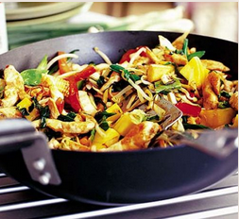
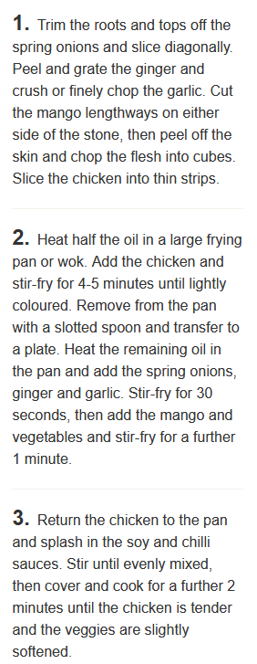
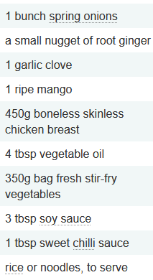
Design Brief: Design and make a savoury product that contributes to our five a day healthy eating guidelines.
Use www.bbcgoodfood.com to research at least 5 recipes that fit this design brief.
You need to include the product name, list of ingredients, product photo and a reason explaining how it fits the design brief.
WAGOLL:
Recipe 1: Chicken & Mango Stir Fry
This dish is low in fat and contains at least 2 portion of vegetables. It is cooked quickly so it retains nutrients.

Slide 16
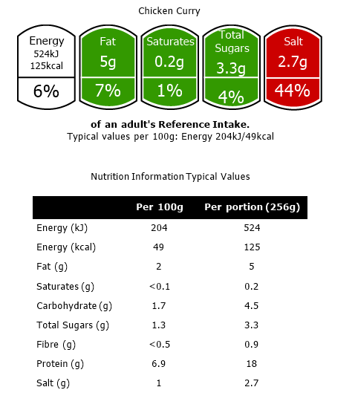
Creating a Traffic Light label for one of your 5 a day dishes:
To calculate the nutritional profile of your product use http://explorefood.foodafactoflife.org.uk/
Click on ‘calculate a recipe’
Type in the product name.
Enter ALL the ingredients that you used in your dish, including the weight in grams.
Type in the number of portions at the top.
Press ‘calculate’.
Click on ‘View summary’ on the bottom left.
Click on ‘Create label’. Name your product.
Use snipping tool to put your label into the space below:
WAGOLL:

Slide 17
If you have an adult to supervise you, you could make some of the dishes that you have researched.
Take a photo of the final dish too if you can.

