Slide 1
Shifting the Balance Year 7
HIAS D&T Team Home Learning Resource
Food and Nutrition

Slide 2
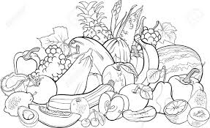
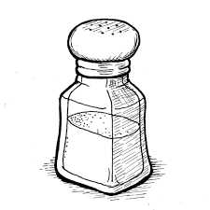
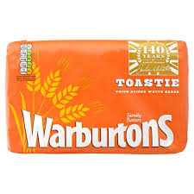
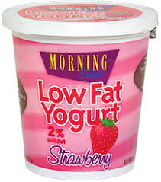
Year 7: Shifting the balance. Name: Date:
Look and learn:
Any food can be enjoyed as part of a healthy, balanced diet. Making a few simple changes to the cooking method or types or amount of ingredients can help you maintain a healthy diet.
Practise: Complete the sentences to describe the alternative ingredients and cooking methods shown by these images
Instead of frying bacon …
Instead of chips try …
Add plenty of …
Avoid high fat foods instead eat …
Do not use …
Swap white bread for …
Challenge:
What changes could you make to the meals (overleaf) healthier?

Slide 3
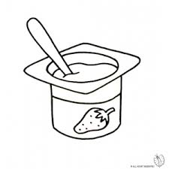
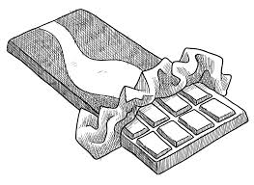
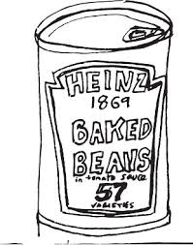
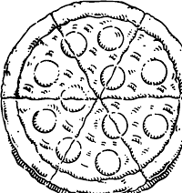
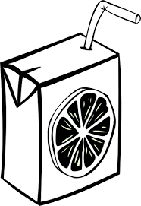
Challenge What changes would you make?
Lunch
Egg mayonnaise sandwich Luxury yoghurt Chocolate Water
What changes would you make? Explain your choices
Dinner
Thin crust pepperoni and cheese pizza Chips Baked beans Orange squash
What changes would you make? Explain your choices

