Slide 1
Equipment Year 7
HIAS D&T Team Home Learning Resource
Food & Nutrition

Slide 2
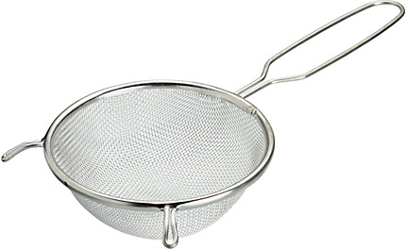
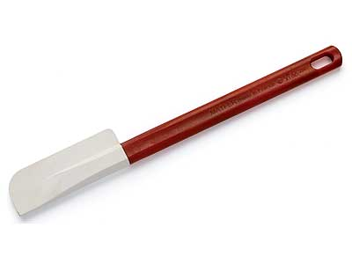
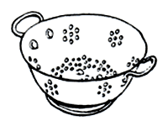
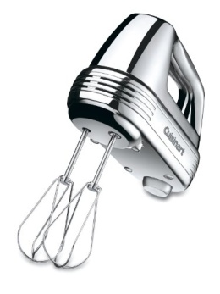
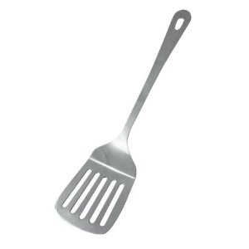
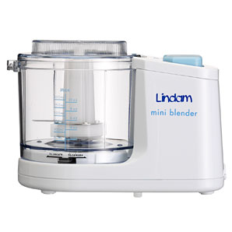
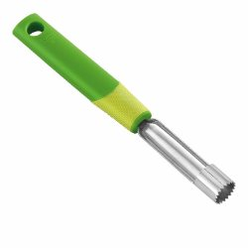
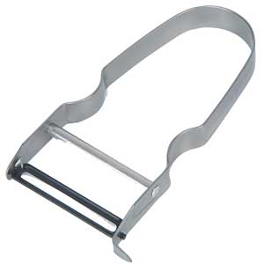
Name: Date: Year 7 : Kitchen Equipment
PW1
Look and learn: Many cooks, new and old obsess about their kitchen gear. There is a dizzying array of knives, mixers, stoves, etc., each claiming to help you be a better cook. Television and magazines would have you think you need a huge gleaming stainless-steel behemoth in order to turn out great food. That just isn’t so! Fancy kitchen appliances won’t make you a gourmet cook anymore than having a great table saw will make me an accomplished cabinet maker. In your lessons you will learn to use a range a kitchen equipment. Let's learn their names.
Practise: Can you match each piece of equipment with its correct name?
Sieve Spatula Fish Slice Colander Whisk Food Processor Corer Peeler Wooden Spoon
------------------------- --------------------------- -------------------------------
------------------------- ------------------------------- ----------------------------
------------------------- ------------------------------ -----------------------------

Slide 3
Challenge: Complete the fact sheet on microwaves
Sketch of a microwave
How do microwave ovens work?
What are the pros?
What are the cons?
What different types are there?
How much do they cost?

